Slide 1


II. Cleaning bad data
The most exciting part of the job
(no)
Notes:
Note: remember to tell students that you will post the corrections for the lab soon
Also, tell them about uploading your CV and some tips

Slide 2
Resources
JA Roderick, Rubin DB. 2019. Statistical Analysis with Missing Data.
QE McCallum. 2013. Bad Data Handbook.
Van der Loo M., de Jonge E. 2018. Statistical Data Cleaning with Applications in R

Slide 3
Last chapter summary
Defining data: it’s never truly objective or factual; it goes through multiple processes of subjective interpretation and possible mistakes
Data analysis plan, and what to put in it
Rundown of what you have to measure, how to do it, with which tools, and what to present depending on what your clients or stakeholders expect

Slide 4
What we will do today
Last class was just a quick review of how to prepare a data project, now we will get to the meat of the course:
We talk about “bad data”: what it is conceptually, in your work, the different “kinds” of bad data
Outliers, validity, missing data, measurement error…
Data cleaning: how to “clean” the bad data

Slide 5
Just got my data…
Very first step as soon as you get your data: look at it (like we did last time)
Don’t jump straight into the analysis though:
Check each (relevant) variable
Think about how it has been gathered in real life
What its distribution should look like
If there are missing values…
Virtually every time you analyse a new dataset, you will come to the conclusion that some of your data is “bad”

Slide 6

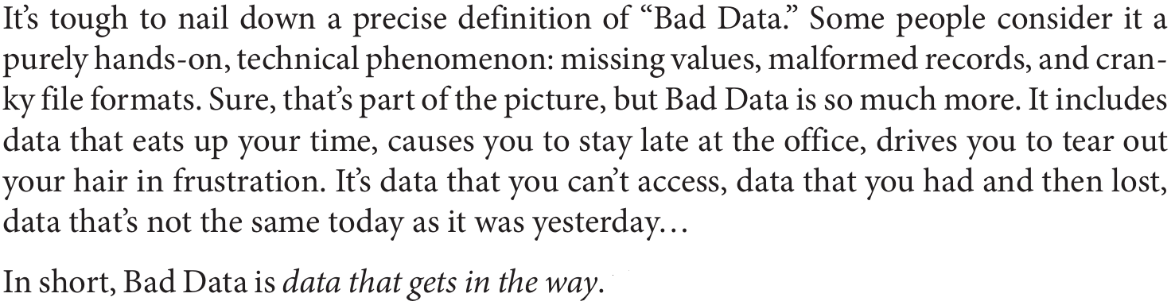
…but it’s bad.
Bad data has multiple definitions and is open to interpretation, but the one from the Bad Data Handbook is great:
“
”
Notes:
Ask students what they think bad data is

Slide 7
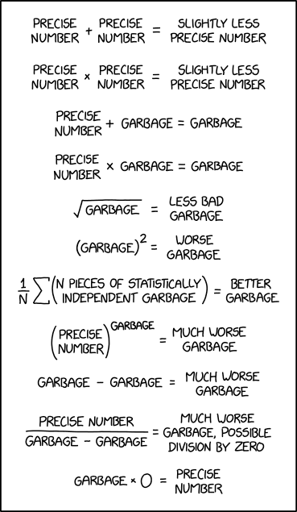
Why should you care? (1)
You could think: “whatever, I’ll start my analyses right away, why should I care if data is missing or unreliable?”
Well-known acronym in programming: “GIGO”, garbage in, garbage out.
Your model and results are always as good your data, it is as important as choosing a correct model (if not more).
xkcd 2295

Slide 8

Why should you care? (2)
Philipp K. Janert:
“A scientist worth his salt is not there to crunch data. A scientist is there to increase understanding: […] understanding of the system that is the subject of the study, not just the data.”
Employability tips
Main selling point as social scientists: in economics, you’re first taught to think about the underlying systems, models, what happens in real life, before even tackling empirical work.
It’s the same when you do data analysis: you don’t just crunch data and show good metrics and p-values, you are there to understand the phenomena you observe with your data
Notes:
Data is just the lens/abstraction through which you observe reality. You are there to inquire about reality, find links and mechanisms that create relationships between phenomenon (variables) or that lead you to have the data that you observe.

Slide 9
Realities of the job
As a data scientist, expect to spend > 50% of your programming time on data wrangling and cleaning
You don’t do enough of this during your studies, where you’ll instead spend 80% of your time learning complicated modelling methodologies
Also, having bad data can be very frustrating:
Takes a long time that you might think would be better spent on analysis
The more you clean, the less sure you are about the accuracy and validity of your analyses
Might feel data quality issues severely undermine the quality of your work and your results
Notes:
Frustration: my example when I started working (I thought my work was bad because of all the data quality issues in the survey I was working on).
One of my interns: spent months on data cleaning, and felt really unsure about her results because of the difficult pipeline that she created
Counterpoint: I think it’s during cleaning that you learn to write good code and to be more efficient. Also, at some point, you realise that some things are out of your control, and you gotta make do with the data that you have. This doesn’t invalidate the hard work that you do.

Slide 10

Before continuing…
A few words of wisdom from Johanna Drucker:
“The very concept of ‘cleaning’ data suggests elimination and purging techniques that should be approached with caution. Some forms of standardization may be engaged without violence to information, while others impose strong acts of interpretation.”
Notes:
Data cleaning is a very subjective process
Especially if you clean it in such a way as to satisfy model assumptions: remember that assumptions are… opinions about how your data behaves. (:

Slide 11
Technical definitions of bad data
Not machine-readable data: data that is made for human consumption, but not machines
Notes:
In advance, any idea of what is bad data?

Slide 12
Help, R doesn’t get my data (1)
Terrible practice
You may find or have data delivered that is not in a readily usable state
Getting rarer as good data practices spread, however
Notes:
Why is it bad?

Slide 13
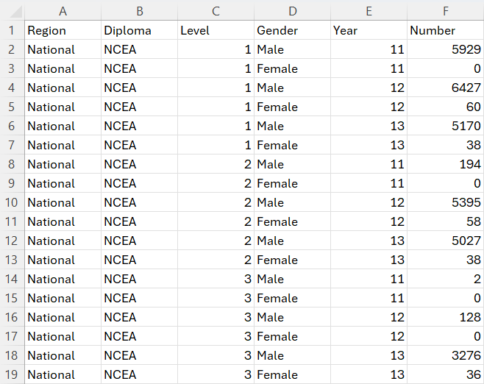
Help, R doesn’t get my data (2)
Proper data should look like this
First row are variable headers
Other rows are observations
Each value should correspond to the
Metadata (information about the data) goes elsewhere, in another sheet or file

Slide 14
Bad tables to good ones
Check options in the function you use for importing data: encoding, row skips, delimiters for non-standard csv files…
Check for packages/libraries that allow to extract data from files that are not usually used to contain tabular data (e.g. pdf files…)
If all else fails: rebuild the data by hand in Excel
Bad practice though: no replicability, possibility of errors

Slide 15
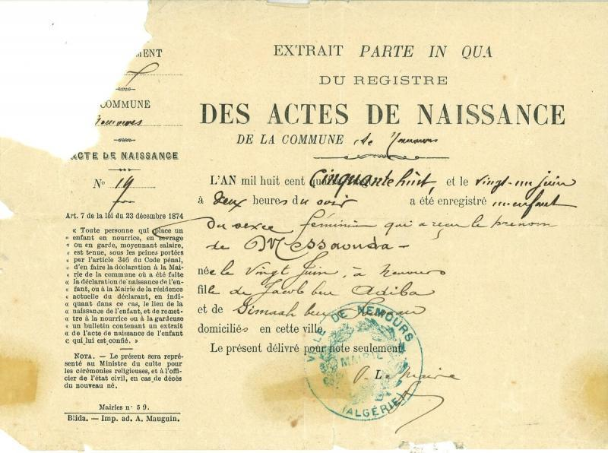
Other non-tabular formats
Other examples of data that are not readily readable as tabular data:
Data from web scraping
Administrative data on paper
Voice recordings (or people giving you information orally)
Can be a big project in itself
E.g. digitizing old data that is on paper, you either pay people to put the data in files, or use optical character recognition (OCR) software
19th century French birth certificate

Slide 16
Technical definitions of bad data
Not machine-readable data: data that is made for human consumption, but not machines
Invalid data: data that do not meet some real world rules or criteria

Slide 17
Invalid data
Most straightforward case of bad data: data that should not happen in reality
You observe your data, but some values violate some “rule”
This rule may stem from common sense, industry knowledge/domain knowledge or other analyses
You will have to work closely with the people that have been working long in the field and who are familiar with what happens in reality, they will help you establish “rules” to define invalid data
Notes:
Ground experts: talk about Guilhem

Slide 18
Invalid data: the checks (1)
Data types
Is the variable of an expected data type?
For example, remember the annual income variable in the previous lab, it was a chain of characters and not a number
Range and distribution of continuous values
Look at the distribution, are the extreme values possible? (e.g. a negative age, or an age of 140 years)
Does the distribution of the data make sense according to domain knowledge?
Categorical variables
Are there modalities that should not exist?
Does the distribution of the modalities make sense according to domain knowledge?
Notes:
Example of helicopters in emergency service data

Slide 19
Invalid data: the checks (2)
Duplicates
The same data may be entered multiple times, check identifying variables
Though sometimes, the same person may have different IDs…
Impossible combinations of values
The values of some variable may restrict the possible range of values on another one
E.g. in a dataset of individuals containing marriage status and age, age should not be under 18 (in France) if the person is married
Totals
Are some variables totals of other variables? Are they still valid if you recompute them?

Slide 20
Invalid data: how to manage?
Correct them:
If you know a way to recover the “true value”: modify the variable
E.g. recompute a total, merge modalities for a categorical variable, modify its type or correct the chain of characters…
Or, if you can’t correct them, delete them:
If you cannot correct it, you better delete it instead of using it
In this case, treat it as missing data (we will see that right now)

Slide 21
Technical definitions of bad data
Not machine-readable data: data that is made for human consumption, but not machines
Invalid data: data that do not meet some criteria
Missing data: data that is simply not there. NAs, empty rows or columns…
Notes:
Credibility: in the data of an emergency service, if half of patients come by helicopter (which is not possible in real life), then you can safely assume the data is very unreliable. Problem is: now you don’t know how much of the data is really usable.

Slide 22
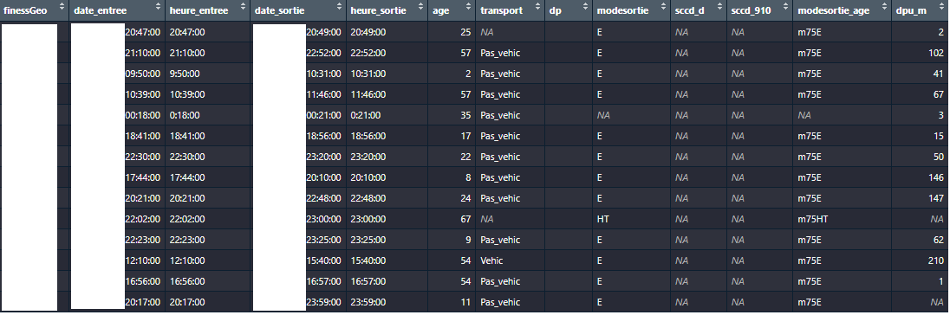
What does missing mean?
xxx
Confidential (:
Also confidential (:
This too (:
xxx
The archetypal example of “bad data”
Instead of actual values, you have NAs (or some type of string that indicate the data is missing : “”, “ “, “x”, “xxx”, “na”, “missing”, “.”)
Watch out for this: in R, missing values should always be NA

Slide 23
My data is missing, what do I do?
First, check how much of it is bad:
If a ‘substantial amount’ (to be determined) of it is unusable, don’t bother, unless you can reconstruct the variable from another source of data
Can be frustrating, but at some point you need to make do with what you have
Then, check if there is a mechanism, or a pattern
Notes:
Sometimes you have to make do with the data you have. If an entire column is not usable, you can’t do anything about it, and trying to salvage it might make it worse.
Also, sometimes it is better to have missing data than being unsure of the validity of a whole column

Slide 24
Mechanisms and patterns in missing data (1)
Why is my data missing? Tons of reasons, actually:
People may refuse to report data, especially if the data is sensitive
Basic human error (if data is gathered manually)
Weird software quirks or failures
Hardware failures
Bored people inputting joke data
Deliberately malicious responses in surveys
People not knowing what to respond in a survey
Notes:
The person inputting the data was bored, or it was deliberately malicious: example of emergency care workers putting some diagnostics as a joke, like “Volcanic eruption at home”. Or, in surveys, people that deliberately answer wrong. Note: some people may argue that it is still valid data (I don’t entirely agree).

Slide 25
Mechanisms and patterns in missing data (2)
Rubin distinguishes “patterns” and “mechanisms”:
Patterns: “which values are missing and observed in the data”
Mechanisms: “relationship between missingness and the values of variables in the data”, that is, why your missing values are missing.

Slide 26
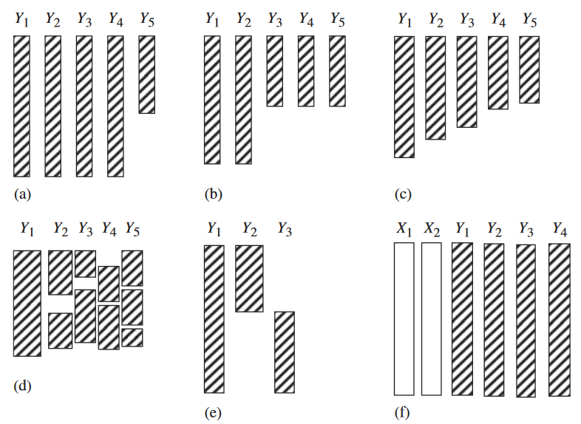
Patterns in missing data
Rubin defines 6 patterns:
Univariate nonresponse (a)
Multivariate nonresponse (b)
Monotone nonresponse (c)
General nonresponse (d)
File matching (e)
Latent variables (f)
Notes:
Rubin distinguishes six patterns

Slide 27
Patterns in missing data
Univariate nonresponse
Missing data in a single variable. Simplest case, but it is quite rare to have missing data in a single variable, I think.

Slide 28
Patterns in missing data
Multivariate nonresponse
Missing data in multiple variable, with the same pattern of missing data.
Frequent in surveys, when respondents stop in the middle of it.

Slide 29
Patterns in missing data
Monotone
Typically happens in longitudinal studies (surveys through time over the same observations) due to attrition (people stop participating)

Slide 30
Patterns in missing data
General nonresponse
Most common type. Missing data in multiple variables, for different observations.
Depending on the type of data, and with some deletion, a monotone pattern can be achieved

Slide 31
Patterns in missing data
File matching
Multiple variables with missing data, but we never observe the missing data in the same rows.
Happens in practice, need to explore further: missing values for each variables could be dependent on other variables

Slide 32
Patterns in missing data
Factor analysis with two latent factors and four measured variables
A latent variable is unobserved data that you can infer from observed data.
Very common in questionnaires

Slide 33
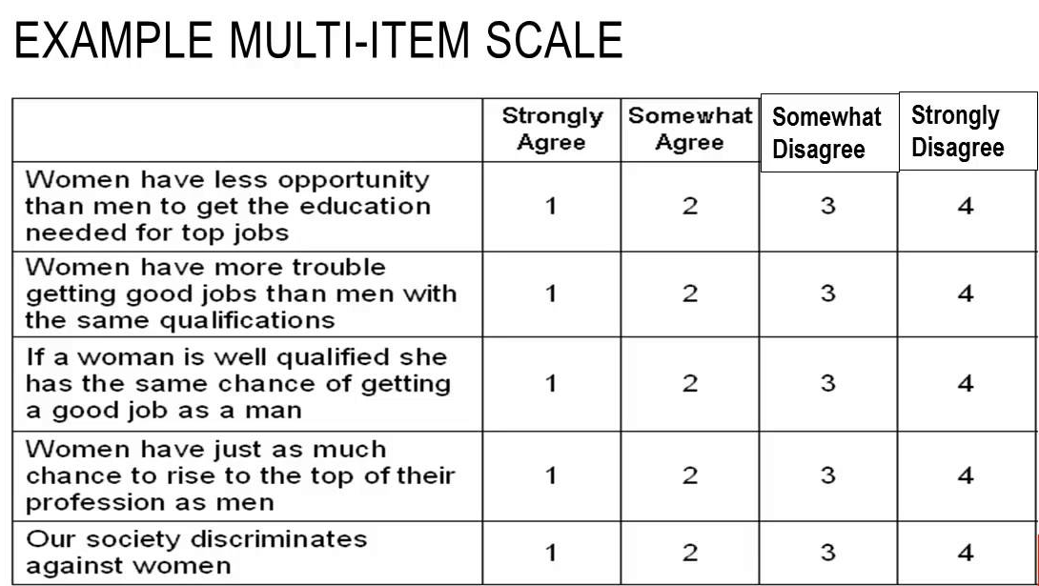
Quick explanation of latent variables
Latent variable: perceived disadvantage of women at work
Positive correlation
Positive correlation
Negative correlation
Negative correlation
Positive correlation
When you have multiple highly correlated variables that share a common underlying theme, you can combine them as one unique variable using dimensionality reduction techniques (e.g. PCA, MCA…)
Notes:
We usually do this to create variables that are hard to measure: happiness, political affiliation, quality of life measures, opinions…
Super common in statistics. Famous example: french deprivation index

Slide 34
Mechanisms in missing data (1)
Missing data mechanisms refer to the real-life processes that leads your data to be missing
There are three, according to Rubin
Notes:
The name MAR is a bit misleading, I think it should be called « missing conditionally at random »

Slide 35
Mechanisms in missing data (1)
The “nice” ones (in my opinion):
Missing completely at random (MCAR): missing data does not come from observed or unobserved factors
Missing at random (MAR): missing data comes from observed factors
E.g. in an income survey, earners from a particular sector (which we know in the data) are less likely to report their income
MCAR is unrealistic: don’t count on it. This assumes the missing data comes from pure chance. This is not testable.
MAR is more realistic: there is an association between missingness and one of the variables in your data. You can test it.
Notes:
The name MAR is a bit misleading, I think it should be called « missing conditionally at random »

Slide 36
Mechanisms in missing data (2)
The “bad” one:
Missing not at random (MNAR): missing data comes from an unobserved factor that you do not have in your data
E.g.: in vaccination surveys, vaccine hesitant people may be more likely to not respond than say they don’t trust vaccines
Arguably, this could be the most common one mechanism: it can exist and affect your data without you knowing it.

Slide 37
Meaning in missing data
Missing data may, in fact, mean something
If that is the case, its meaning is usually found in the data dictionary, or through people that created/gathered the data
Survey nonresponse can be a special case of missing data:
For some questions, nonresponse can be very telling…
“How often do you recommend vaccination to patients?”
“What is your opinion on general vaccination”, or “… on XYZ vaccination?)
Despite not giving any response, this can be interpreted as avoidance or reluctance: this missing data can be used in analyses, or be grouped with negative answers (these respondents could very well have poor opinion of vaccination, but prefer not declare it!)

Slide 38
Solutions to missing data
We will see the two most common ones for MAR and MCAR: deletion and imputation
The other big one is likelihood-based approaches
I will kindly refer you to JA Roderick, Rubin DB. 2019. Statistical Analysis with Missing Data.
This can handle MNAR data, because you explicitly model the missingness mechanism
In my experience, most opt (mistakenly?) for simple or multiple imputation, though you may often argue that missing data is MNAR
In my opinion, this could be due to lack of knowledge about other methods, and mostly lack of time and expertise to model the missing data mechanism…
Notes:
Reason why we mostly do imputation: time and lack of knowledge about more complicated methods, I guess. It’s very time consuming to do, and you don’t have infinite time when working on projects. We are usually aware of these limitations.

Slide 39
Deleting data
Worst solution: delete all rows with missing data (a.k.a. “complete case analysis”)
Do this only if you have few missing values over few variables
“randomly deleting 10% of the data from each variable in a matrix of five variables can easily result in eliminating 59% of cases from analysis”
Obvious risks:
Loss of statistical power & accuracy
More conservative estimates (i.e. less likely to find significant results)
Less obvious risks:
Your data might not look like your population (i.e. reality) anymore, this is extremely problematic
Check the characteristics of your kept observations: must be similar to excluded observations
Notes:
Example: in a questionnaire

Slide 40
Simple imputation (1)
Replace missing values with a single value, based on other rows in your data
Can be obtained through multiple methods, from the most simple to most complicated
Easiest is imputation by the mean or median:
Calculate the mean (or median) of the variable among observed values
You can stratify by the values of one or multiple categorical variables, for better accuracy
Easy to do in R, with dplyr in a mutate: using a case_when, replace only missing values with the mean or median of the variable

Slide 41
Simple imputation (2)
There also are model based approaches:
Hot deck
Form of nearest neighbour imputation
Select one random observation that is identical (or very similar) to the one with the missing data
Use the observed value of this random observation as imputation
Regression (or any ML model):
Fit a model on the observed data, with regressors of your choice
Predict missing values using the trained model

Slide 42
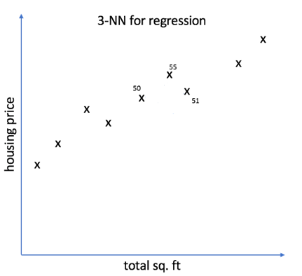
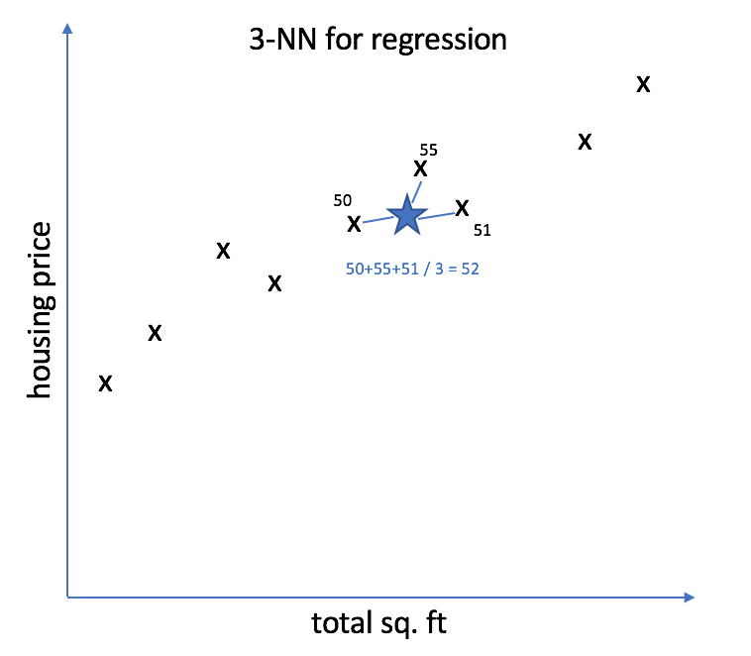
Simple imputation (3)
One missing value to impute:
Take mean of target variable of the 3 nearest neighbours
Three nearest neighbours to observation with missing data
kNN imputation
More sophisticated than hot deck: instead of only one, select the k nearest neighbours to the data point you wish to impute
Take the average observed value of these k nearest neighbours

Slide 43
Multiple imputation (1)
There is always uncertainty when imputing however: you will never know the true value behind the missing data
One way to solve this is to introduce variability in the imputation process by repeating it multiple times

Slide 44
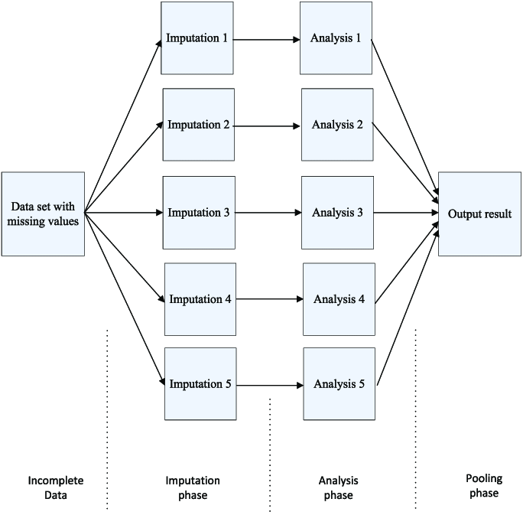
Multiple imputation (2)
Create multiple datasets, with different imputed values using models that allow some variability in the predictions
E.g.: stochastic regression, Random Forest
R packages:
mice (multiple imputation by chained equations)
miceRanger (mice with Random Forest)

Slide 45
Limits of imputation (1)
It is not a magic bullet, there are situations where imputation will not help you:
You have too much missing data
When the data is MNAR: this will make your data even less representative of reality. You must take into account the process that creates missing data.
This may not be usable in some contexts: in longitudinal data (where you follow the same patients over time), imputing data for respondents with missing data from one year to the next should not be done!
Notes:
Longitudinal: reason is that you risk imputing, for some variable for person x at time t, an average that is totally unrelated to the value of the variable at time t-1 or t+1
Some don’t trust imputation at all: it is common practice in big national surveys to have missing data already imputed, some researchers or data scientists immediately drop this data

Slide 46
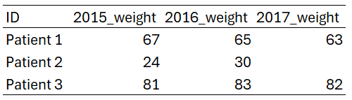
Limits of imputation (2)
Example of where imputation would fail on longitudinal data:
If you blindly took the mean of the 2017 weight across patients to impute the weight of patient 2, it would be totally incorrect
Think about what your imputation means in the context of data
Notes:
Ask students why taking the mean of 2017_weight would not work

Slide 47
Technical definitions of bad data
Not machine-readable data: data that is made for human consumption, but not machines
Invalid data: data that do not meet some rules or criteria
Missing data: data that is simply not there. NAs, empty rows or columns…
Outliers: data that is “abnormal” with regards to other values
Notes:
Credibility: in the data of an emergency service, if half of patients come by helicopter (which is not possible in real life), then you can safely assume the data is very unreliable. Problem is: now you don’t know how much of the data is really usable.

Slide 48

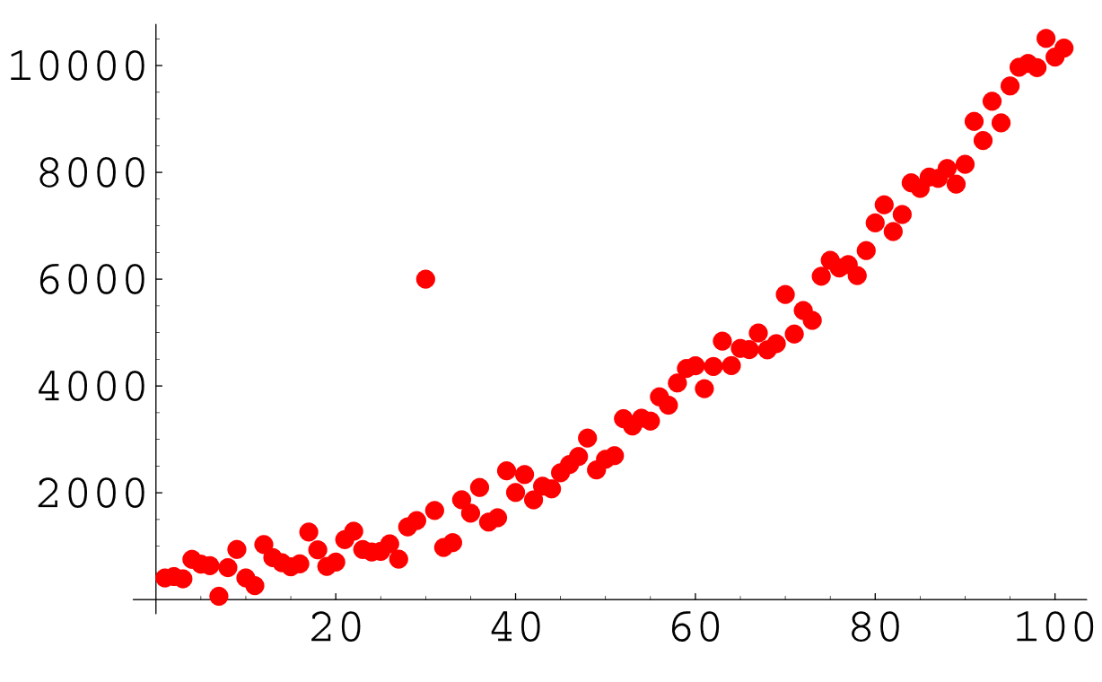
Outliers - Examples
Can you find the outlier here?

Slide 49
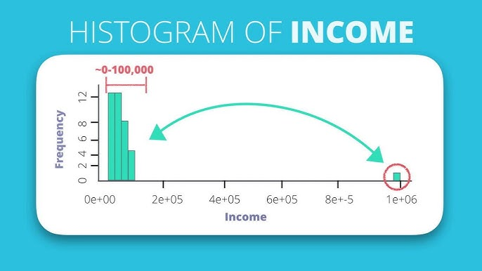
Outliers - Examples
And here?

Slide 50
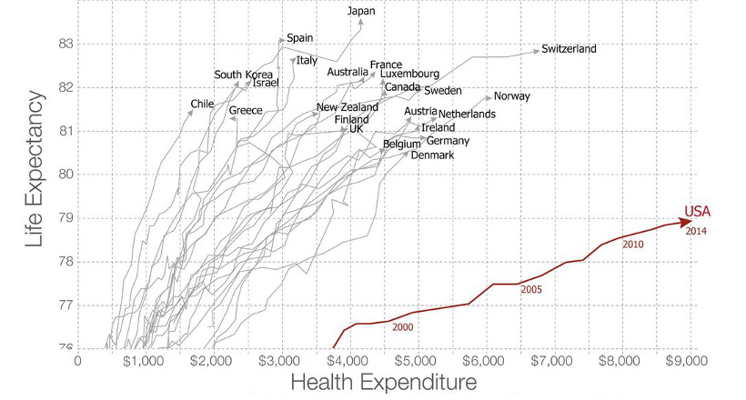
Outliers - Examples
What about this one?

Slide 51






Outliers - Examples
Here?
Notes:
Explain the example

Slide 52

Outliers
An outlier is any data point that is substantially different from others, in the context of the dataset
The usual method of dealing with outliers is deletion
You would not impute it or modify it, because an outlier is valid, it exists in real life
Remember that deletion technically means: this data point does not exist in real life
Food for thought: minorities are, in a way, outliers
Notes:
Why would you not impute it?
By deleting it, you will make the choice of not modeling it.
Examples:
* Merging non-binary persons with another gender (due to lack of statistical power for them)
* In my experience, overseas France may be considered outliers or not considered in analyses

Slide 53
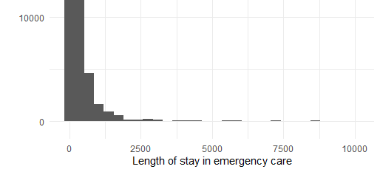
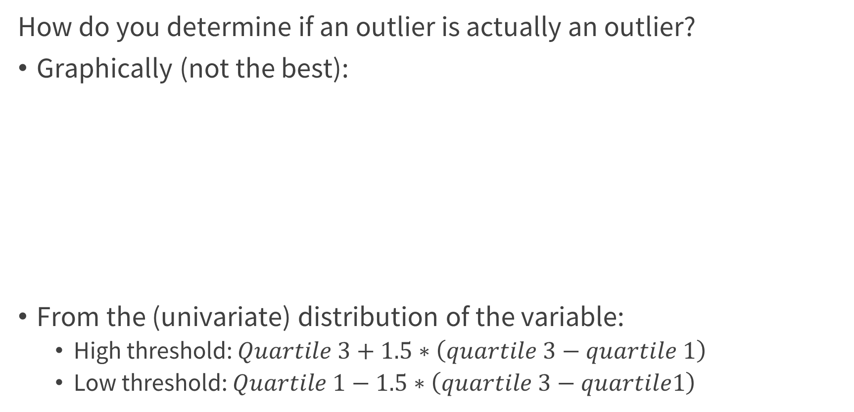
Finding outliers (1)
How do you determine if an outlier is actually an outlier?
Graphically (not the best):
From the (univariate) distribution of the variable:
High threshold: $Quartile 3+1.5∗\left(quartile 3−quartile 1\right)$
Low threshold: $Quartile 1−1.5∗\left(quartile 3−quartile1\right)$
Have fun debating where to
put the threshold
N
Notes:
Why 1.5? Something to do with the gaussian distribution
You can change this, by the way. It’s not set in stone. You can choose 2, or 3, if you want to be really stringent.

Slide 54
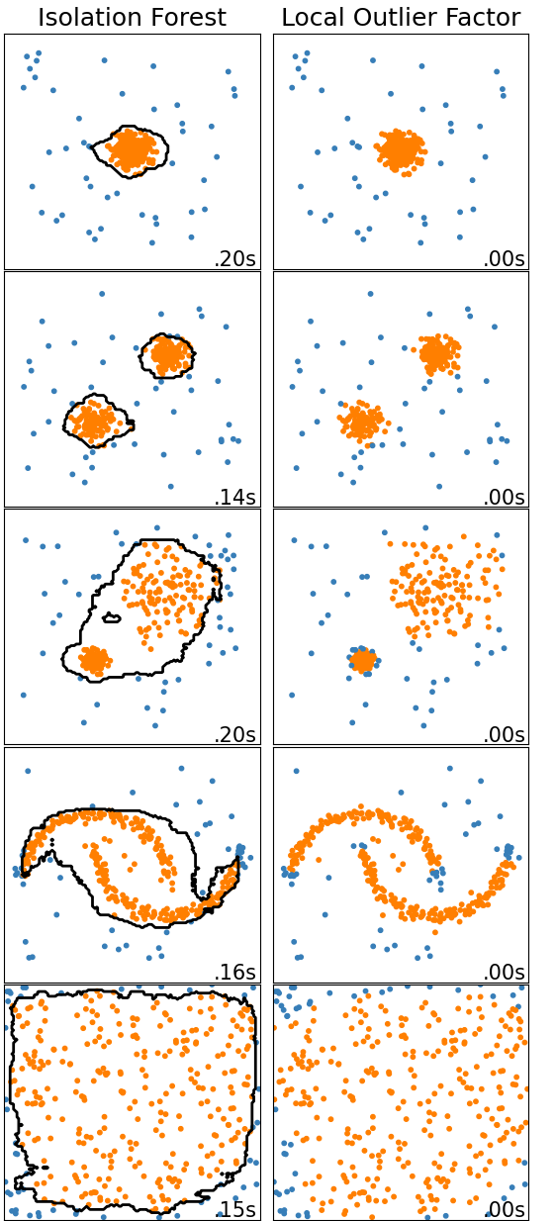
Finding outliers (2)
Automated detection methods:
Local outlier factor: calculates density around each point and assigns a score (higher values -> more likely to be an outlier)
Isolation forest: recursive random partitioning of the data, observations that are alone after few partitions are more likely to be outliers
Detection can be done over multiple variables. But it is more of a black box. Also, you still need to define a threshold.
There are others (search on scikit-learn, or online)
Notes:
Never have had the use of these methods, personally. It’s there if needed.
Threshold: at which value of the score do you decide to define data points above it as outliers

Slide 55
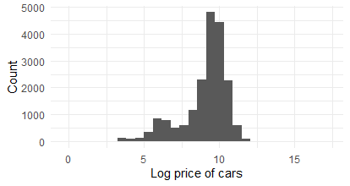
Finding outliers (3)
Nothing stops you from combining methods, though with most techniques, you need to define a threshold
Outliers are usually deleted…
But don’t erase data blindly, consider first whether it is really an outlier, and then whether it is information you actually want to discard
Not all modelling strategies are sensitive to outliers: it’s less of a problem with, let’s say, random forest
Do you delete the 20 million dollars car?

Slide 56
Technical definitions of bad data
Not machine-readable data: data that is made for human consumption, but not machines
Invalid data: data that do not meet some criteria
Missing data: data that is simply not there. NAs, empty rows or columns…
Outliers: data that is “abnormal” with regards to other values
Measurement error: valid data with incorrect input
Methodologies to define and remedy to missing data will differ depending on the nature of your data

Slide 57
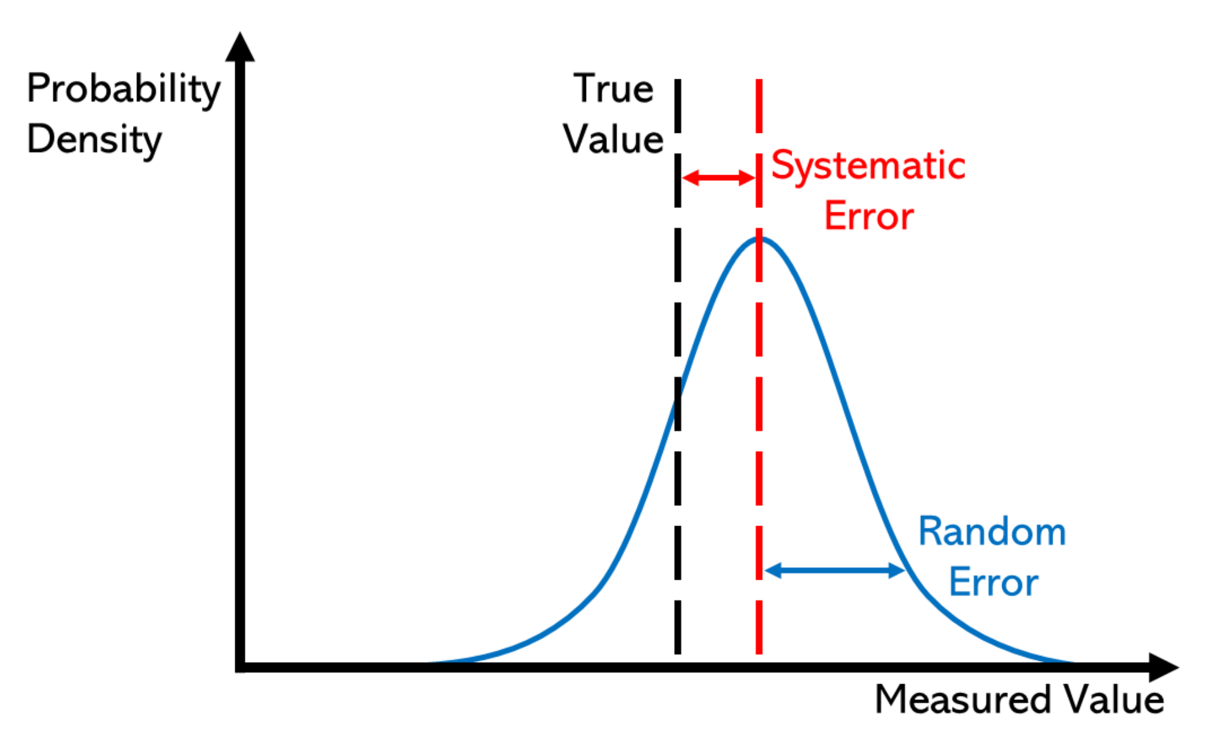
Measurement errors: definition
Sometimes, values in your dataset can be valid (i.e. they can happen in real life) but still be different from their “true values”
In my opinion, this is the worst case of “bad data”:
You may never know that your data is inaccurate
If you know there are measurement errors in a variable, you may not know where
Measurement error can be:
Random, this increases the variability in your data
Systematic error, the measurement error will always be the same and lead your data away from its “true value”
You could also call this “bias”
Notes:
Random: think of it like some faulty equipment that randomly moves your data points away from their true values. Like a scale that randomly adds or substracts up to one kg
I deliberately avoided using the word bias throughout the class, though that is actually a common theme in all the problems I explained. That will be a topic in the next class, where we will actually think about all the mechanisms that lead to bad data.

Slide 58
Measurement error: detecting from outside the data
Sometimes, these are skills that are “less of a ‘data scientist’ and more of a ‘gum shoe detective’”
Real difficulty is that you can’t always spot measurement errors just by crunching the data:
Ask people who collected the data, or experts who know what happens on the ground…
Or go directly to where the data is collected (especially in manufacturing, for example)

Slide 59
Measurement errors: why?
Variety of sources
Could be human input that is at fault:
Bored people gathering the data and inputting junk data
Subjectivity
Simple random error
Incentives
Faulty hardware or software quirks:
Improperly calibrated or poorly maintained hardware
Software that outputs wrong data in specific circumstances (bugs)

Slide 60
Measurement errors: solving
If you know there is a systematic error but cannot figure out in which observations and have no idea how to correct it: forget about it, don’t use this variable
If you can somewhat determine where errors are, you could treat it like you would missing data
Use the techniques presented previously, keeping in mind
There is a lot more to it: techniques and models we can use to correct specific types of measurement errors (or “biases”)
We will see that in next class

Slide 61
Measurement errors: examples
Emergency service data: each patient is assigned a severity score (scale of 1 to 5) when they depart
Financing reform in 2020: emergency services receive more funding when they treat “severe patients” (scale >= 3)
Of course, the proportion of severe patients suddenly rose after 2020
Especially in private clinics…
This variable is unreliable after this date: we can’t know if some patients are really “severe patients” or patients with a severity score of 2 that was bumped to 3.

Slide 62
Measurement errors: avoiding
Once your data is gathered, you must deal with its problems and quirks either way…
But it is good practice to implement changes in how the data is collected
Report any incorrect measures, and how these came to be
Realistically speaking, improving how the data is collected is not always possible, but it will never improve anyway if you don’t act on it

Slide 63
Next time
Programming, again:
You will work (alone or in groups) on a very messy dataset with (synthetic) real life emergency service data
I won’t help you much

